Slide 1

Notes:
Cover Slide

Slide 2


Topic Name
DATA ARRANGEMENT
(Circular Relationship)

Slide 3
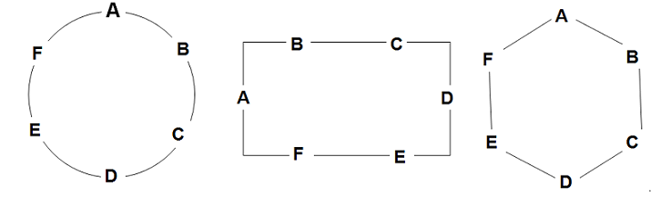
Circular Arrangement
A Circular arrangement can be defined as an arrangement having a closed loop. Typical examples include situations wherein seating arrangements around a table have to be made. The table can be of any shape and need not necessarily be circular. This is illustrated by the following diagrams.

Slide 4
Circular Arrangement
Though the above diagrams look very different in terms of their structure, there would be minimal deviations in the interpretation of some common clues for all these diagrams.
For example,
A is sitting opposite to D.
B is sitting to the immediate left of A.
B is sitting between A and C.

Slide 5
Circular Arrangement
Movements around the circular arrangement:
For the people facing the centre:
Left movement is called clockwise rotation.
Right movement is called anti-clockwise rotation.
For people facing outside, the opposite is true:
Left movement is called anti-clockwise rotation.
Right movement is called clockwise rotation.

Slide 6
Directions to Solve
P, Q, R, S, T, U, V and W are sitting round the circle and are facing the centre:
P is second to the right of T who is the neighbour of R and V.
S is not the neighbour of P.
V is the neighbour of U.
Q is not between S and W. W is not between U and S.

Slide 7
Question: 01
Which two of the following are not neighbours ?
RV
UV
RP
QW
Answer: A

Slide 8
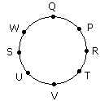
Explanation:
From the above diagram R and V are not neighbours

Slide 9
Question: 02
Which one is immediate right to the V ?
P
U
R
T
Answer: D

Slide 10
Explanation:
T is immediate right to the V.

Slide 11
Question: 03
Which of the following is correct ?
P is to the immediate right of Q
R is between U and V
Q is to the immediate left of W
U is between W and S
Answer: C

Slide 12
Explanation:
Option C is the correct answer

Slide 13
Directions to Solve
Read the following information given below and answer the questions that follow.
P, Q, R, S, T, U and V are seven friends and are sitting in a circle facing the center of the circle.
V is second to the left of S and is the neighbour of T and U.
S is not a neighbour of R or T.
P is neighbour of Q and R.

Slide 14
Question: 04
Which of the following is correct?
Q is between P and S.
S is between U and P.
T is to the immediate right of V.
U is to the immediate left of V.
Answer: A

Slide 15
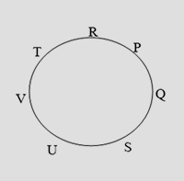
Explanation:
The persons are sitting in the following way:
Hence Q is between P and S.

Slide 16
Question: 05
Which of the following has the pair with the second person sitting to the immediate right of the first person?
QU
VU
TR
PT
Answer: B

Slide 17
Explanation:
The persons are sitting in the following way:
U is sitting to immediate right of V.

Slide 18
Question: 06
Which of the following will be S’s position after T and S interchange their places?
Neighbour of V and R
To the immediate left of R
To the immediate right of U
Neighbour of R and P
Answer: A

Slide 19
Explanation:
The persons are sitting in the following way:
If S and T will interchange their positions then S will be the neighbour of V and R.

Slide 20
Question: 07
Which of the following has the second person sitting between the first and third persons?
SPQ
VRT
QRP
VUS
Answer: D

Slide 21
Explanation: 07
The persons are sitting in the following way:
U is sitting between V and S.

Slide 22
Directions to Solve
Study the information given below and answer the given questions.
Eight friends A, B, C, D, E, F, G and H are sitting in a circle, but not necessarily in the same order. Four of them are facing outside and four of them are facing the centre.JTS Institute Bank PO Exams -Work Book 27 JTS Institute .
1. E faces outside, Both the immediate neighbours of E face the centre. H sits second to the right of E. B sits third to the left of E.
2. D faces the centre. Both the immediate neighbours of D face outside.
3. G sits second to the left of A. B sits third to the right of H
4. F is an immediate neighbour of D. C is an immediate neighbour of G.
5. D is not an immediate neighbour of B.

Slide 23
Question: 08
Who amongst the following sits exactly between F and C (and is also their neighbour)?
E
B
A
G
Answer: B

Slide 24
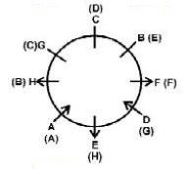
Explanation: 08
Option B is the correct answer.

Slide 25
Question: 09
If all the people are made to sit in an alphabetical order, in clockwise direction, starting from A, the position of whom amongst the following remains the same (excluding A )?
E
G
C
F
Answer: D

Slide 26
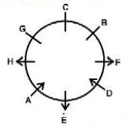
Explanation:
Option B is the correct answer

Slide 27
Question: 10
Four of the following five are alike in a certain way, based on the information given above and so form a group. Which is the one that does not belong to that group?
HA
FH
GC
DA
Answer: C

Slide 28
Explanation:
Option C is the correct answer

Slide 29
Directions to Solve
Study the following information carefully and answer the given questions.
A, B,C, D, E, F, G and H are sitting around a circle facing the centre but not necessarily in the same order.
B sits second to the left of H’s husband. No female is an immediate neighbour of B.
D’s daughter sits second to the right of F. F is the sister of G. F is not an immediate neighbour of H’s husband.
Only one person sits between A and F. A is father of G.
H’s brother D sits on the immediate left of H’s mother.
Only one person sits between H’s mother and E.
Only one person sits between H and G. G is the mother of C. G is not an immediate neighbour of E.

Slide 30
Question: 11
Which of the following is true with respect to the given seating arrangement?
C is cousin of E.
Hand H’s husband are immediate neighbours of each other.
No female is an immediate neighbour of C.
H sits third to the left of her daughter.
B is mother of H.
Answer: E

Slide 31
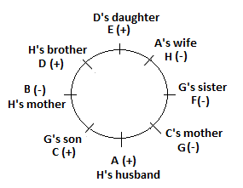
Explanation: 11
Option E is the correct answer.

Slide 32
Question: 12
Four of the following five are alike in a certain way based on the given information and so form a group. Which is the one that does not belong to that group?
F
C
E
H
Answer: B

Slide 33
Explanation:
Except C, all are females.

Slide 34
Question: 13
What is the position of A with respect to his grandchild?
Immediate right
Third to the right
Third to the left
Second to the left
Answer: A

Slide 35
Explanation:
C is grandchild of A. Thus A's position with respect to his grand child is immediate right.

Slide 36
Question: 14
Who amongst the following is D’s daughter?
B
C
E
G
Answer: C

Slide 37
Explanation:
Option C is the correct answer

Slide 38
Question: 15
What is the position of A with respect to his mother-in-law?
Immediate left
Third to the right
Third to the left
Second to the right
Answer: D

Slide 39
Explanation:
B is mother-in-law of A. Hence, A's position with respect to his mother-in-low is second to the right.

Slide 40
THANK YOU

